Slide 1
Digital design
Ch 5. Synchronous sequential logic

Slide 2
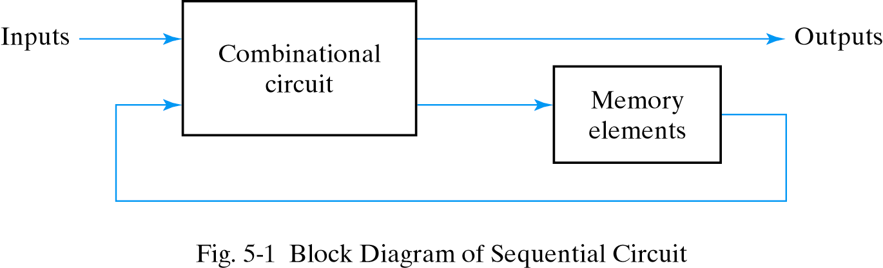
5-2 Sequential circuits
Outputs are function of inputs and present states
Present states are supplied by memory elements

Slide 3
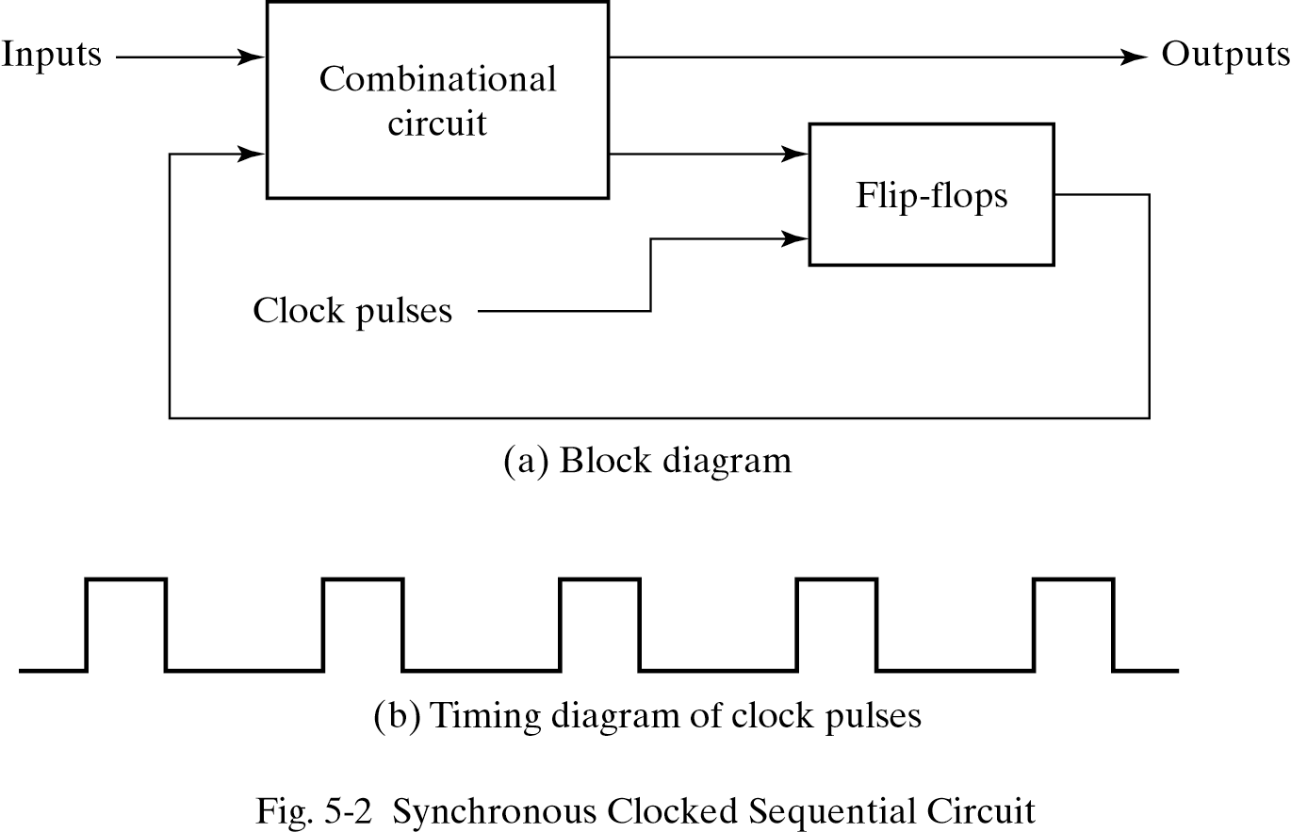
Sequential circuits
Two types of sequential circuit
  Synchronous : behavior depends on the signals affecting storage elements at discrete time
  Asynchronous : behavior depends on inputs at any instance of time and the order the input change

Slide 4
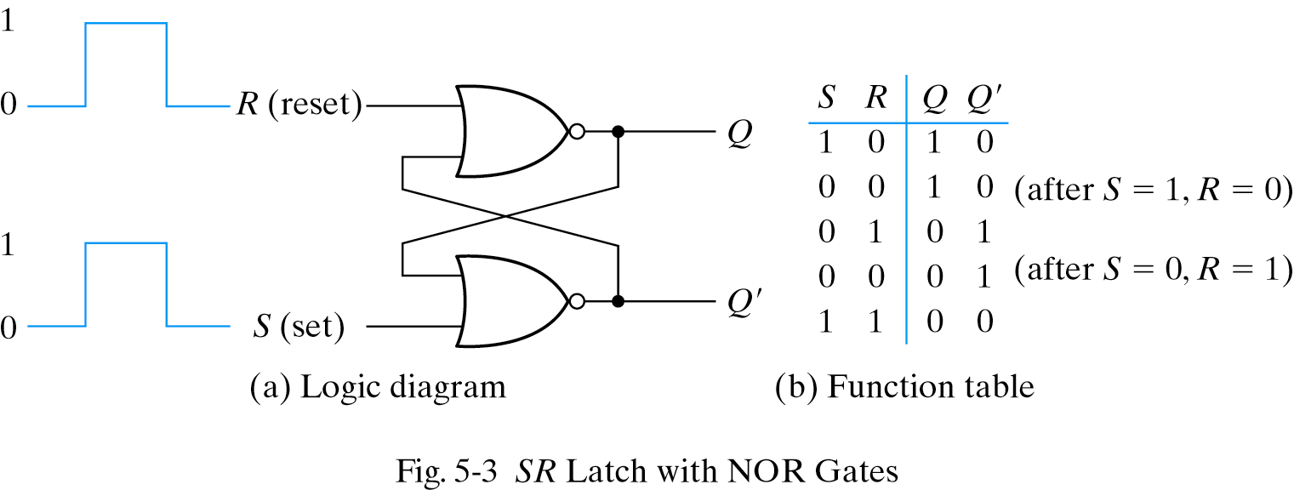
5-3 Latches
SR latch : consist of two cross-coupled NOR gates
  S=1,R=0 then Q=1(set)
  S=0,R=1 then Q=0(reset)
  S=0,R=0 then no change(keep condition)
  S=1,R=1 Q=Q′=0 (undefined)

Slide 5
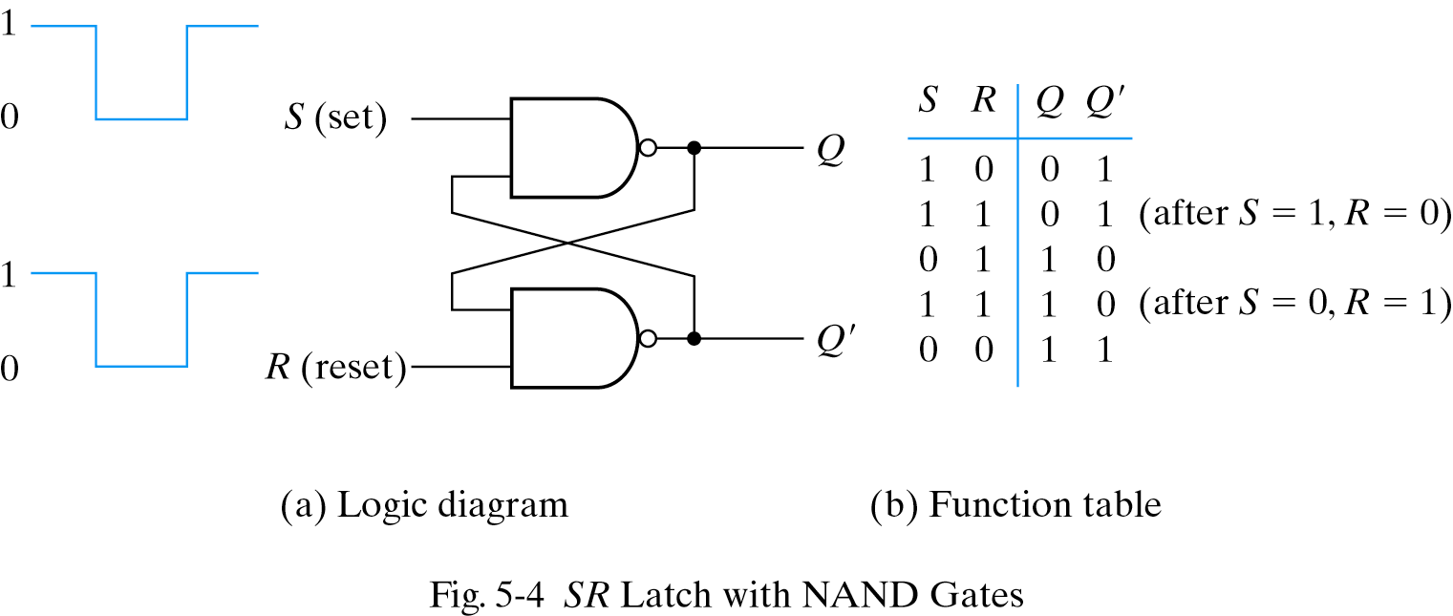
S′R′ latch with NAND gates
Require the complement value of NOR latch

Slide 6
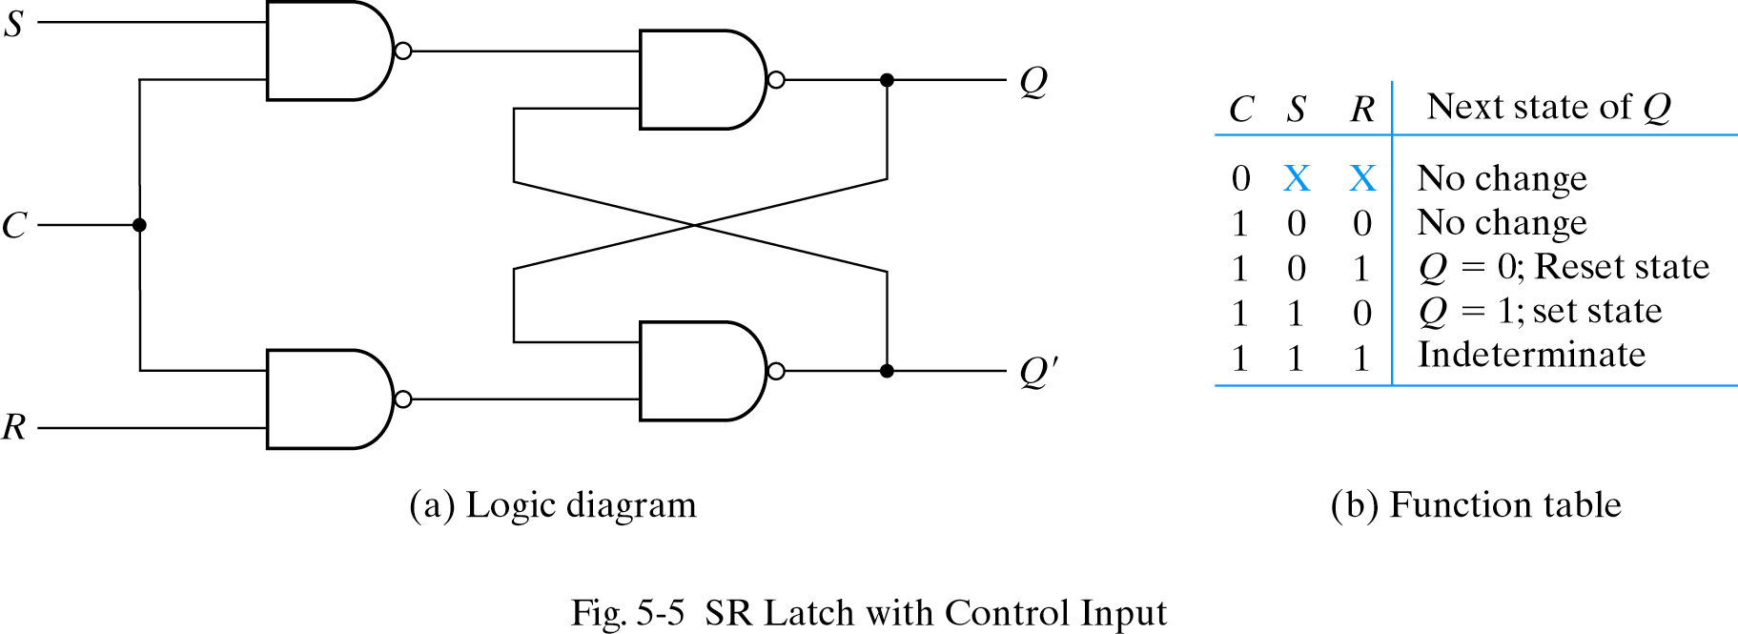
SR latch with control input
Add two NAND gate and control signal
C=0(no action), C=1(act as SR latch)
CLK

Slide 7
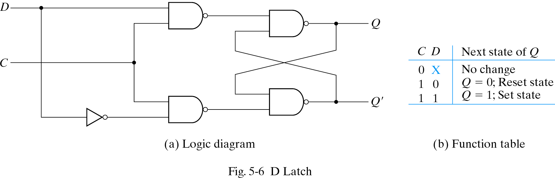
D latch
Eliminate indeterminate state in SR latch
C=1, output value is equal to D

Slide 8



5-3 Flip-flops
Latch : case (a), output changes as input changes
Flip-flop : output only changes at clock edge

Slide 9
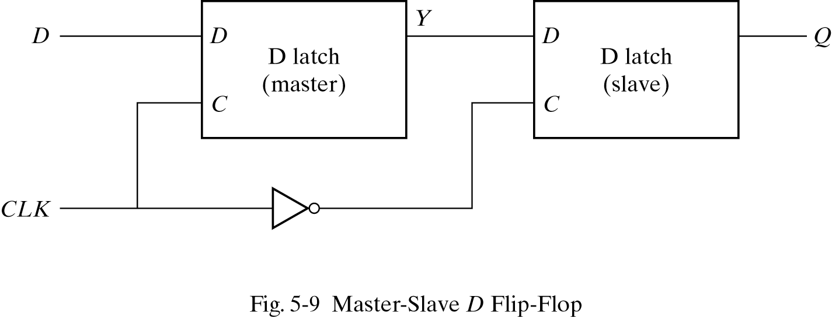
Master-slave D flip-flop
Negative edge triggered D flip-flop
C=0 : master disable, slave enable
  Output has no relation with input
C=1 : master enable, slave disable
*

Slide 10
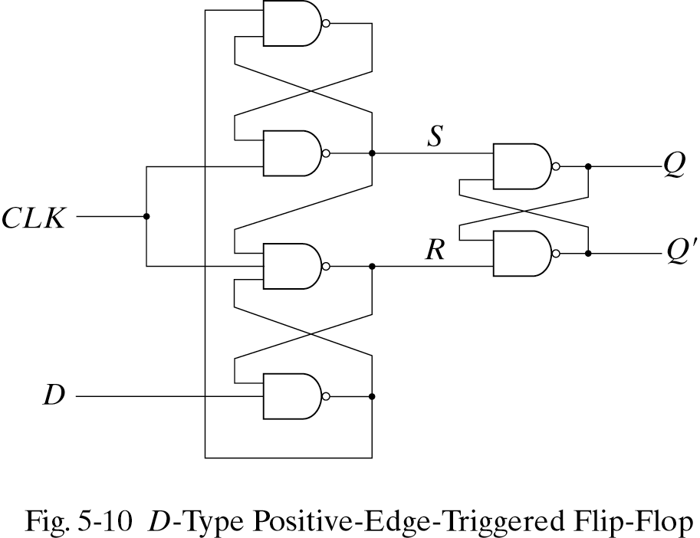
D-type positive edge triggered flip flop
Consist of 3 SR-latches

Slide 11
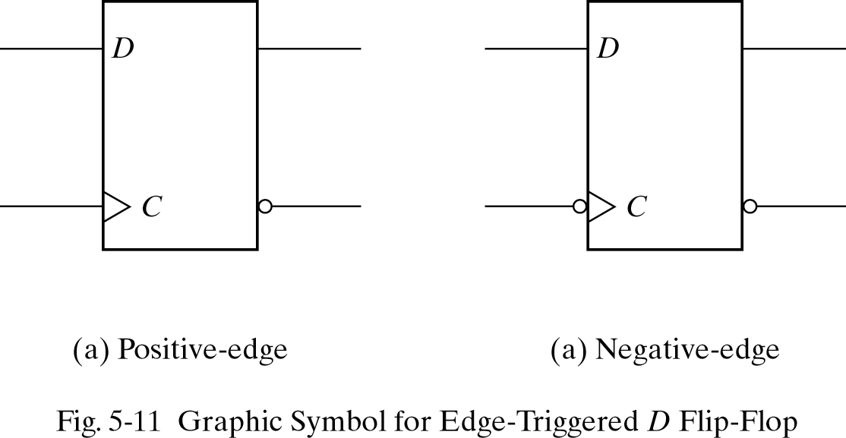
D-type positive edge triggered flip flop
Consist of 3 SR-latches
Q changes only when C becomes 0 to 1

Slide 12
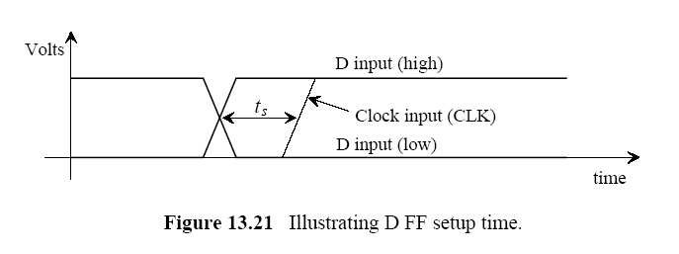
Setup time / Hold time

Slide 13
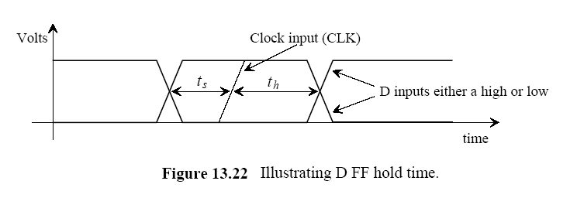
Setup time / Hold time

Slide 14
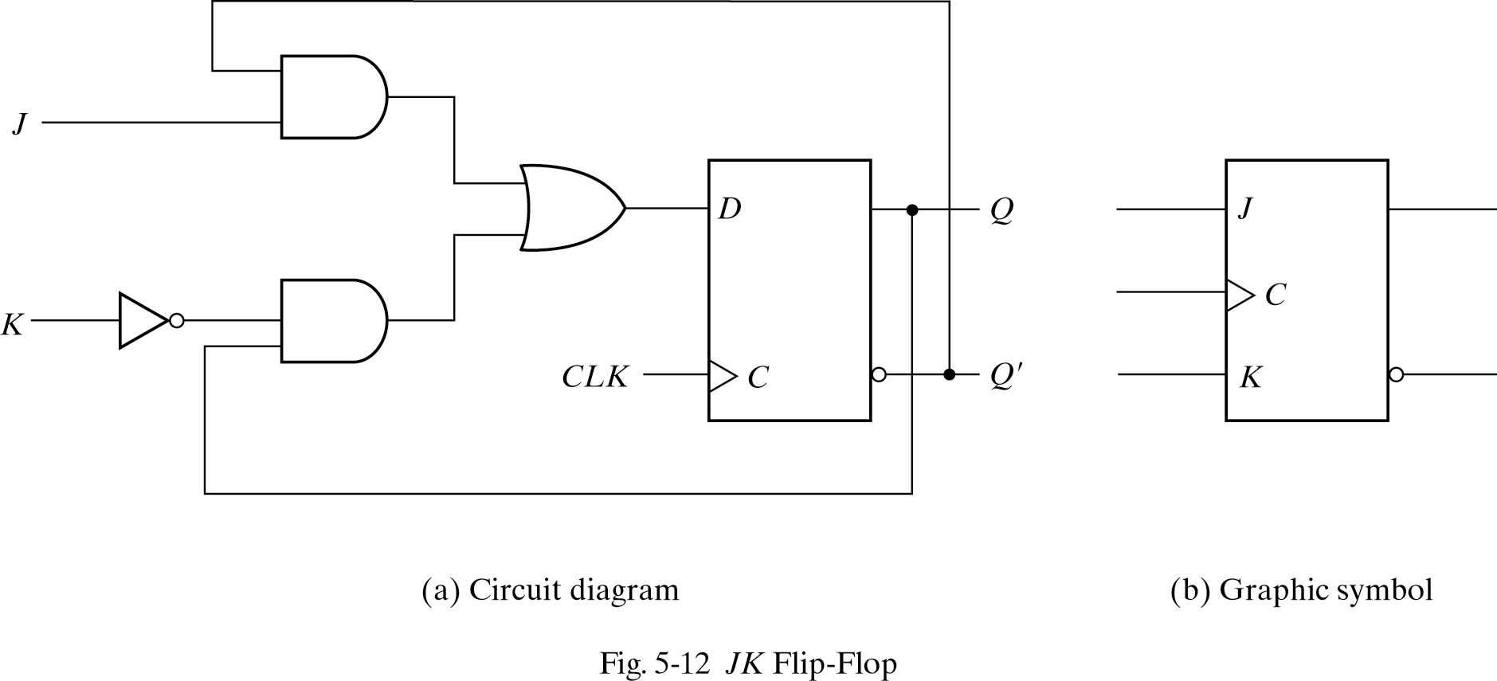
JK flip-flop
Performs three operations
  Set(J), Reset(K), Complement(J=K=1)
  D=JQ′+K′Q
ASIC Lab.
*

Slide 15
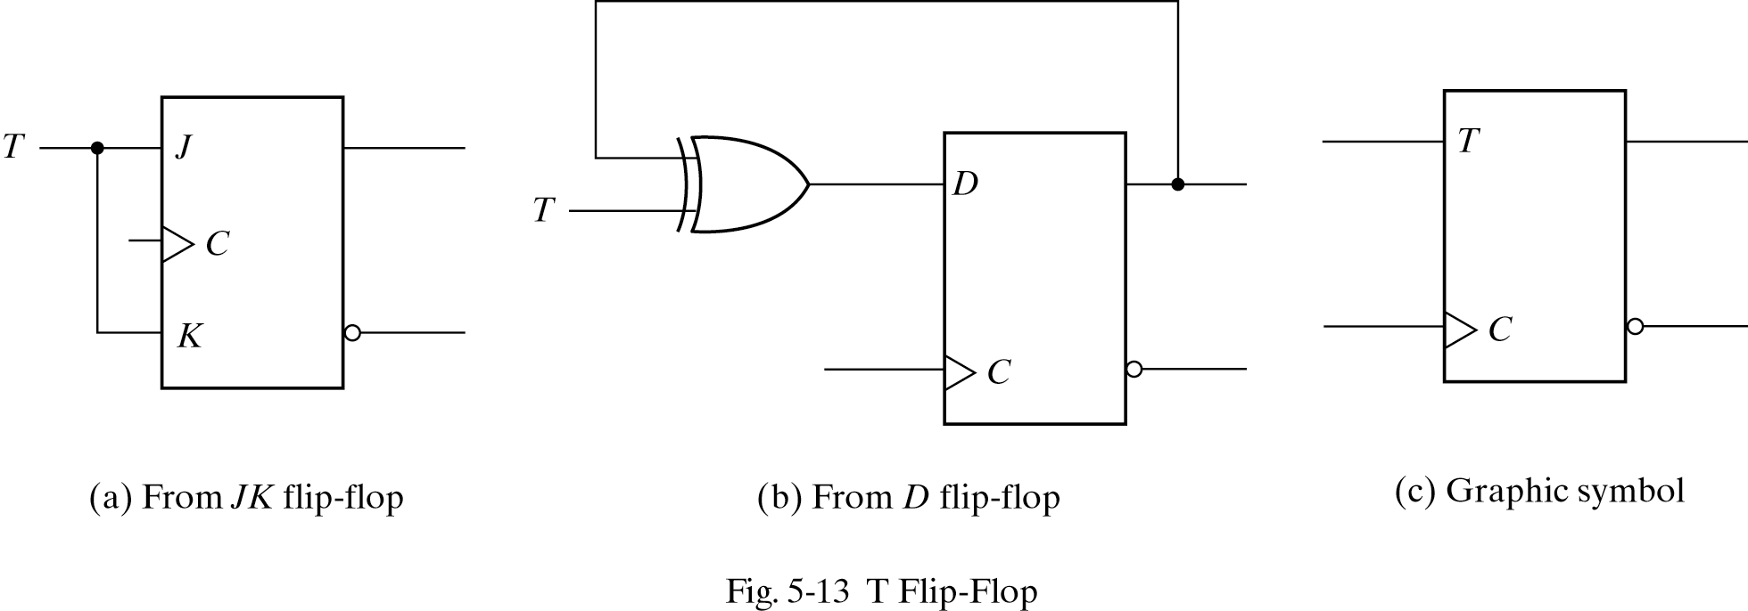
T flip-flop
Complementing flip-flop
D=TQ′+T′Q

Slide 16
D flip-flop with asynchronous input
Reset

Slide 17
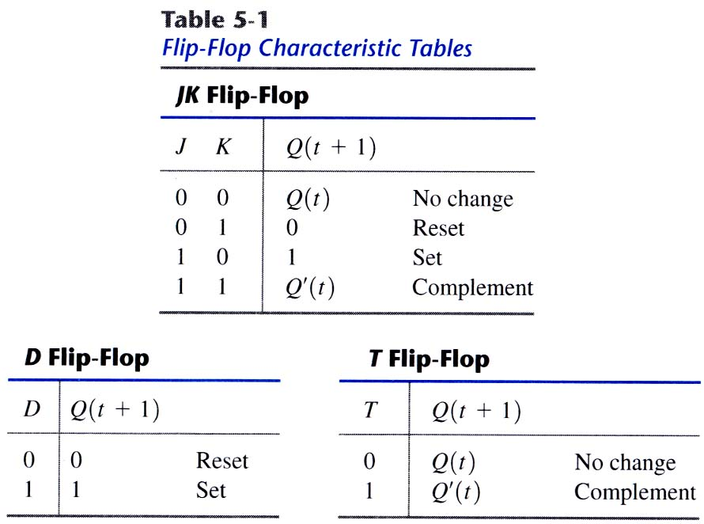
Characteristic tables
Flip-flop characteristic tables
ASIC Lab.
*

Slide 18
5-5 Analysis of clocked sequential circuits
Behavior of clocked sequential circuit is determined from input, output and present state
Output, next state are a function of input and present state

Slide 19
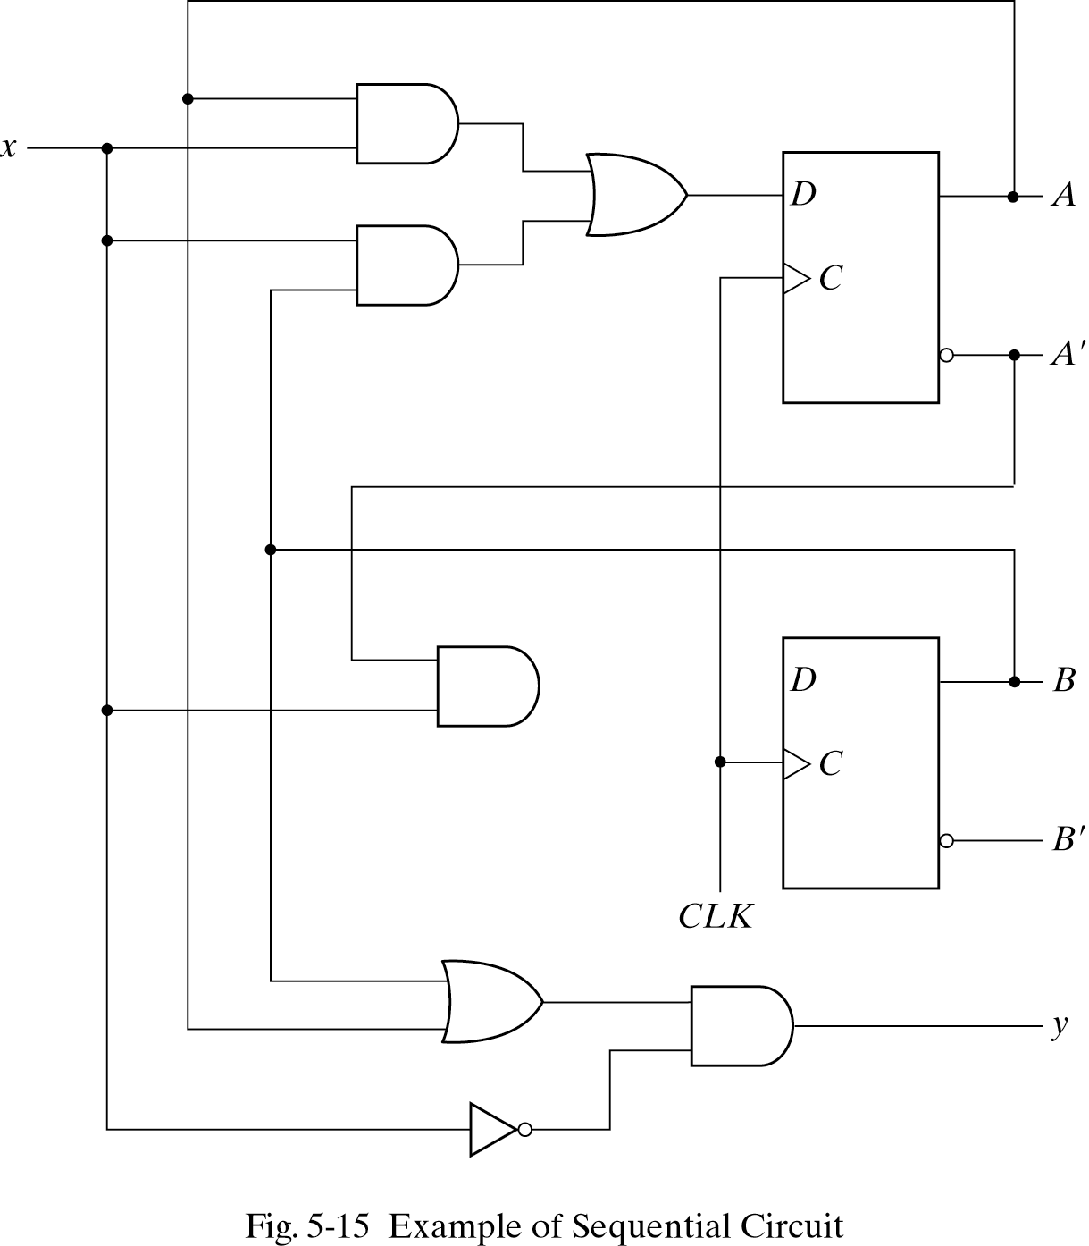
State equations
Specifies the next state and output as a function of the present state and inputs
A(t+1)=Ax + Bx
B(t+1)=A′x
Y=(A+B)x′
mealy model
ASIC Lab.
*

Slide 20
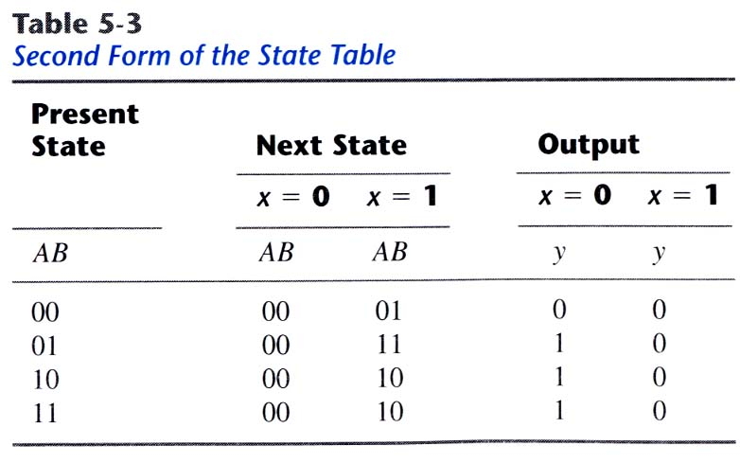
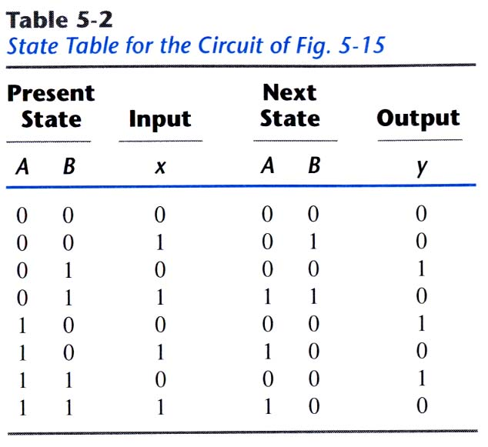
State table
Time sequence table of inputs, outputs and flip-flop states
two types of state table exist

Slide 21
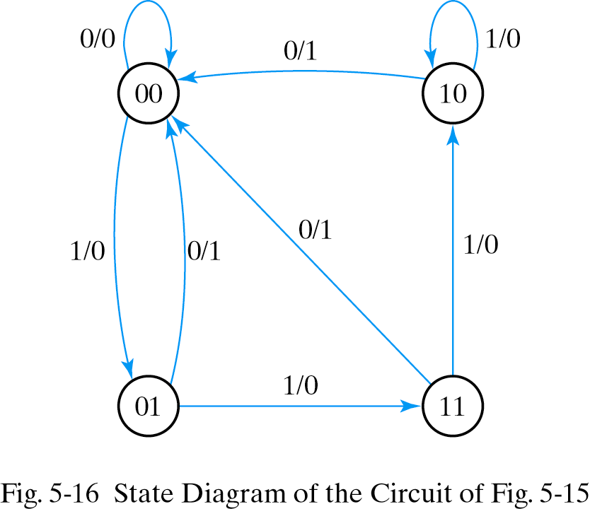
State diagram
A kind of flow diagram
Can be derived from state table
  State-circle, transition-line, I/O
ASIC Lab.
*

Slide 22

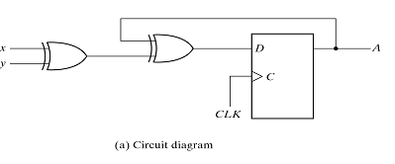
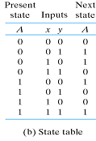
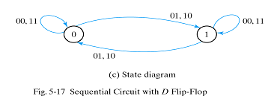
Analysis with D flip-flops
Input equation :
State equation is equal to input equation
moore model
ASIC Lab.
*

Slide 23
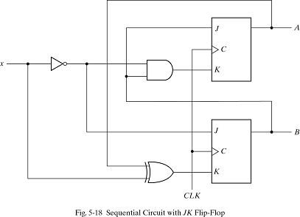
Analysis with JK flip-flops
State equation is not the same as the input equation
Have to refer characteristic table
or characteristic
equation
Input equations
JA=B KA=Bx′
JB=x′ KB=A′x+Ax′
moore model
ASIC Lab.
*

Slide 24
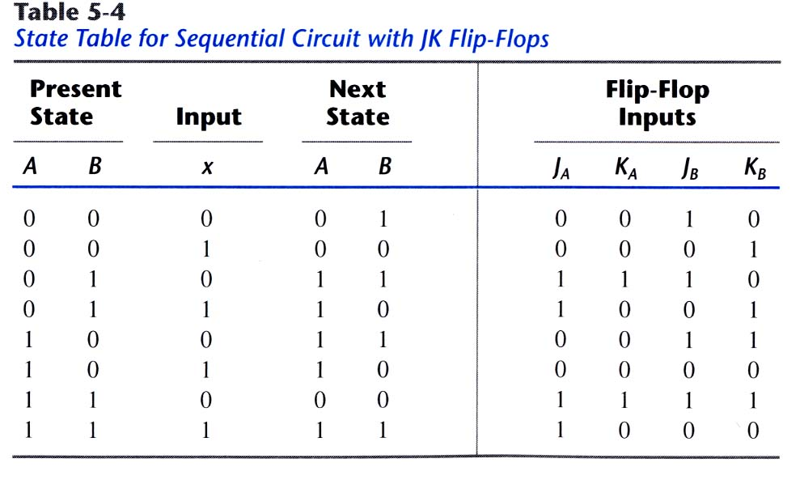
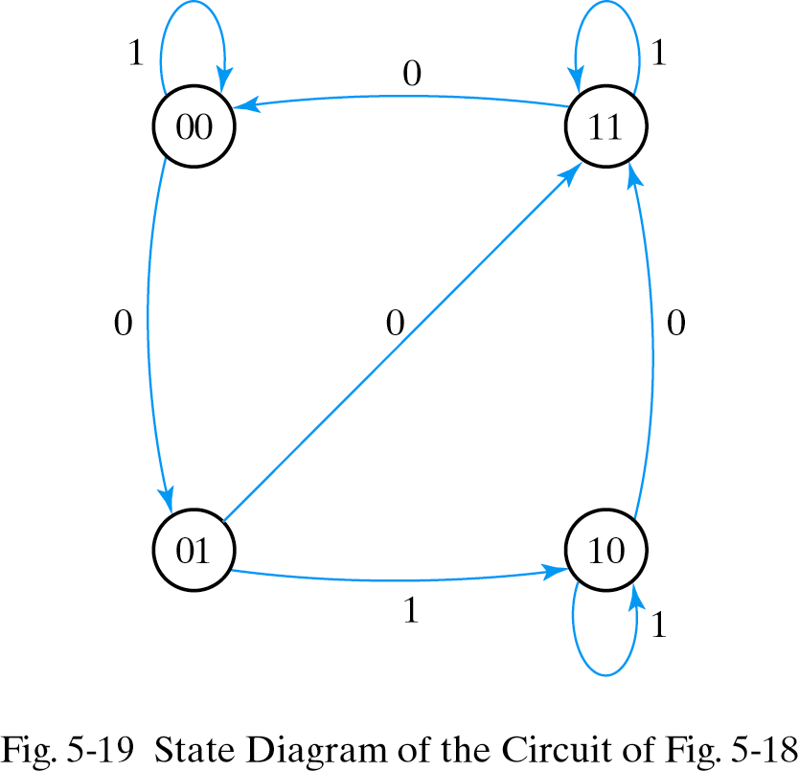
Analysis with JK flip-flops
JA=B KA=Bx′
JB=x′ KB=A′x+Ax′
State table and state diagram
00 부터 시작
1
3
2
4
ASIC Lab.
*

Slide 25
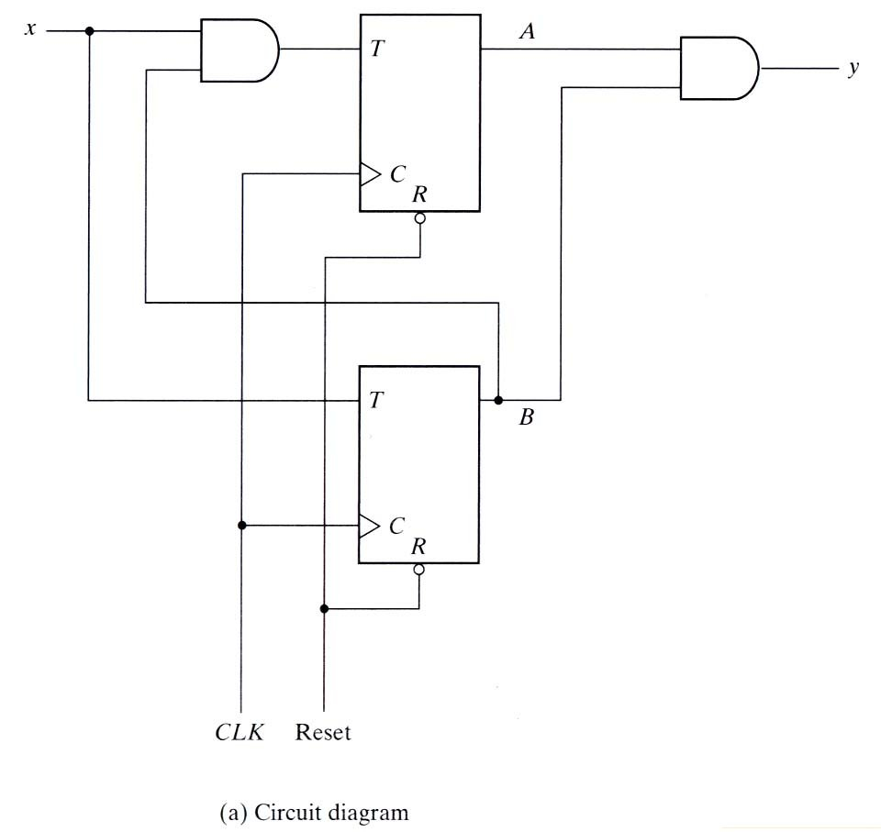
Analysis with T flip-flops
Input equations and output equation
TA=Bx, TB=x
y=AB
State equations are
derived from
characteristic equation
A(t+1)=TAA′+TA′A
B(t+1)=TBB′+TB′B
moore model
ASIC Lab.
*

Slide 26
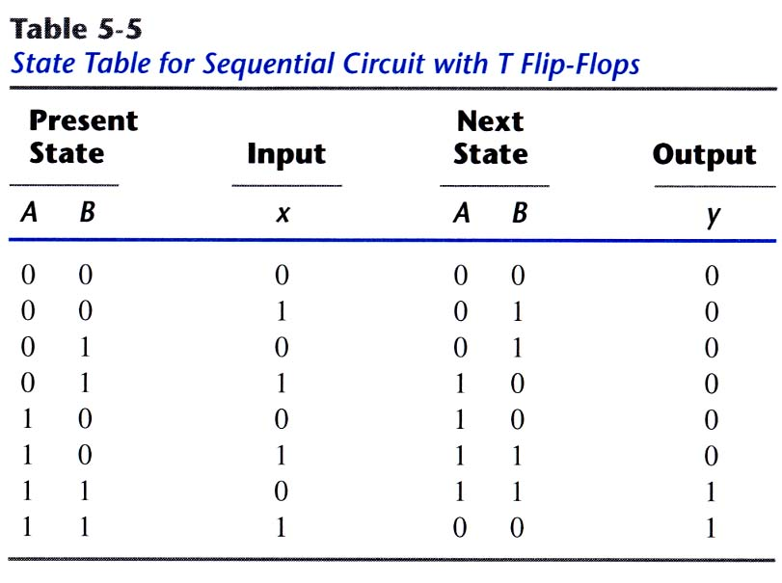
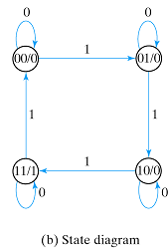
Analysis with T flip-flops
항상 현재값을 출력함 다음께 아니라 현재값
State/output
Input
ASIC Lab.
*

Slide 27
Mealy and Moore models
Mealy model : output is a function of the present state and input
  Inputs must be synchronized with the clock
  Outputs must be sampled at the clock edge
Moore model : output is a function of the present state only (moore model: input 을 고려하지 않고 현재 state만 고려한다)
  Outputs are synchronized with the clock
ASIC Lab.
*

Slide 28
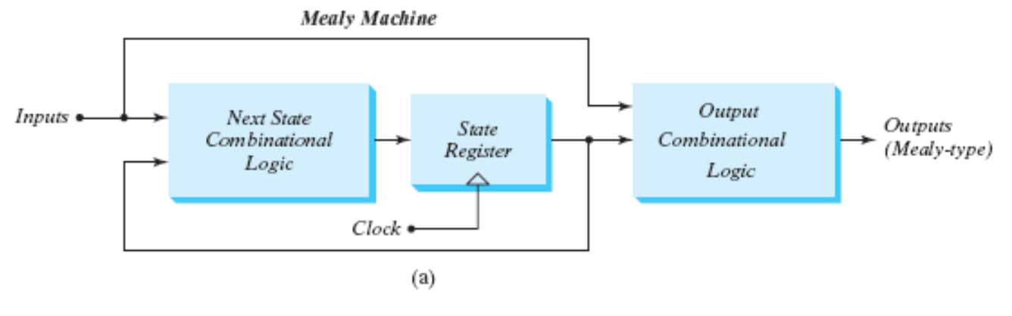
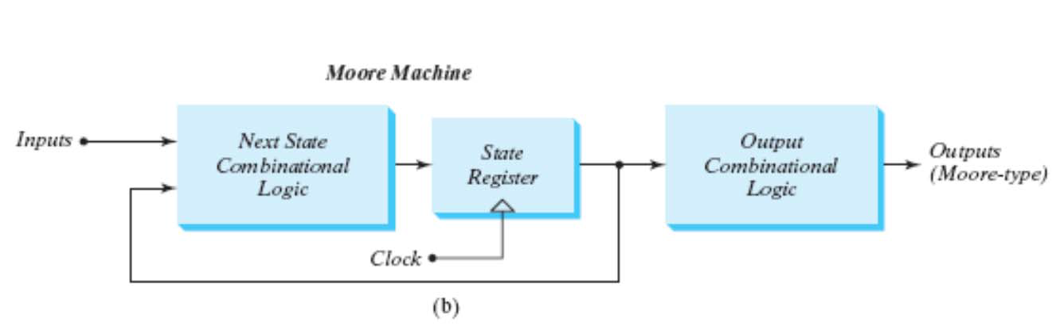
mealy: x/y
Q------->Q
moore: x
Q-------->Q
ASIC Lab.
*

